Slide 1
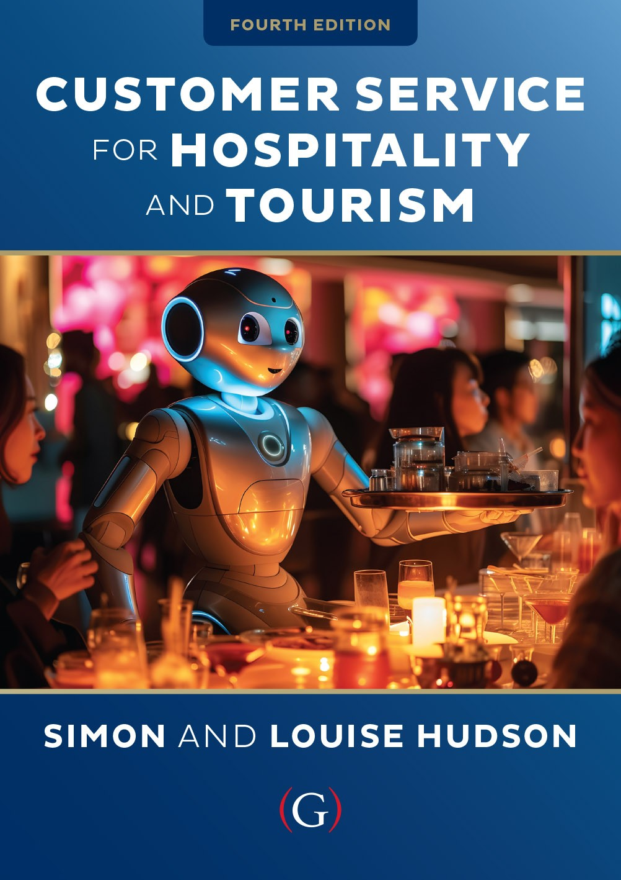
Chapter 5
Managing service encounters

Slide 2

Topics covered
  The employee role in delivering service
  15 techniques for delivering guest service
  Customer service training
  The customer role in delivering service
    The importance of customer-to-customer interactions
    Enhancing customer participation

Slide 3
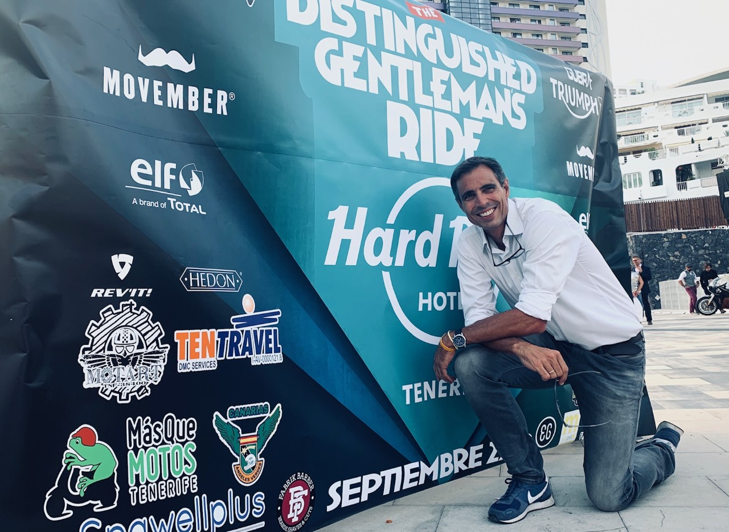
‘At Your Service’ Spotlight:
Ten Travel in Tenerife
Wooing businesses and keeping travelers happy.
Business and incentive travel - high level of specialization
  Positioned between tourism and business
  Solving problems for customers
  Maintaining service levels
  Beyond usual tourist trips
Employing and retaining the ‘right people’
  Dedicated local experts
Behind the scenes
  Service negotiations, recovery
  Detailed planning
  Budget considerations
During the pandemic Ten Travel stayed in permanent contact with their valued clients; “Platforms such as Teams and Zoom have taken personal interaction to the next level and we have made good use of them”

Slide 4
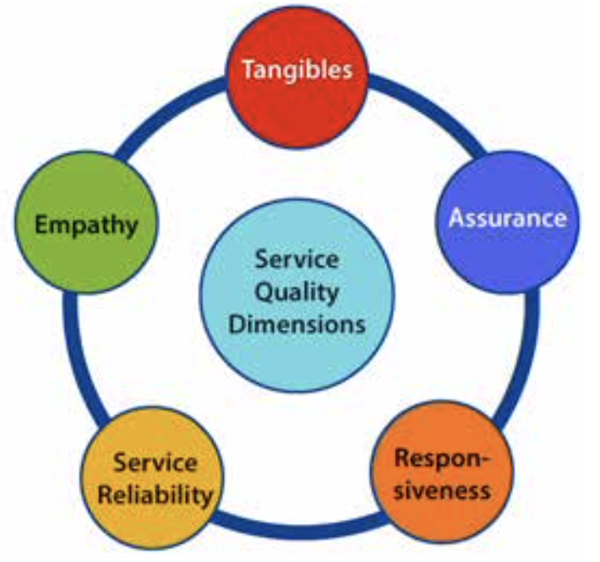
Employees’ role in delivering service
Service encounters first and foremost social encounters
Interactive marketing occurs at the ‘moment of truth’
Service quality judged over five dimensions:
  Assurance
  Empathy
  Reliability
  Responsiveness
  Tangibles
‘Emotional labor’
    Engage strangers
    Suppress real feelings
    Cope with emotional stress

Slide 5
15 service techniques at ‘the moment of truth’
CUSTOMER SERVICE TECHNIQUE | DESCRIPTION
1) Promptly greet all customers | Nobody likes to be ignored, made to wait. Greet the customer like a guest in your own home
2) Use appropriate icebreakers | Break the ice with safe conversation starters, build rapport based on common interests
3) Compliment freely and sincerely | Customers love to be complimented – even if they know it may not be truly genuine.
4) Call customers by their name (if known) | People love nothing more than the sound of their own name..
5) Make and maintain eye contact with customers | Eye contact creates a bond between you and your customer. You are creating ‘Involvement.’
6) Ask for feedback | You want to know as soon as possible if there are any problems in the service delivery.
7) Listen carefully | Use appropriate nonverbal signals and receptive language; listen to what the speaker is saying.
8) Use effective service vocabulary | Use positive phrases and words that build customer rapport and loyalty.
9) Smile freely and often | Customers often indicate that they feel valued when they receive a smile.
10) Appropriately touch customers when possible | Physical touch is a powerful form of communication.
11) Enjoy people and their diversity | Avoid the tendency to judge; accept diversity for the quality it brings to our lives.!
12) Have a good attitude about your job | You will benefit from having a positive attitude about life.
13) Keep your workplace clean and attractive | It is important to create a strong first impression by keeping the workplace attractive to the eye
14) Dress and groom yourself appropriately | Determine what level of professionalism you want to convey and dress appropriately
15) Maintain a good body posture | Posture involves the way you position your body. You should appear attentive and ready to assist.
Table 5.1 (based on Timm, 2008)

Slide 6
Customer service training
‘We are ladies and gentlemen serving ladies and gentlemen.’
- Ritz Carlton company credo
Service oriented firms reluctant to invest in training
Small firms wary of time, finances, resource investments
Strong correlation between training, employee retention
Requires more than a single program or class
  Initial and ongoing (e.g. Disney & Singapore Airlines))
Service providers may look externally for training
Should include how to serve ethnically and socially diverse customers (eg. customers with disabilities)

Slide 7
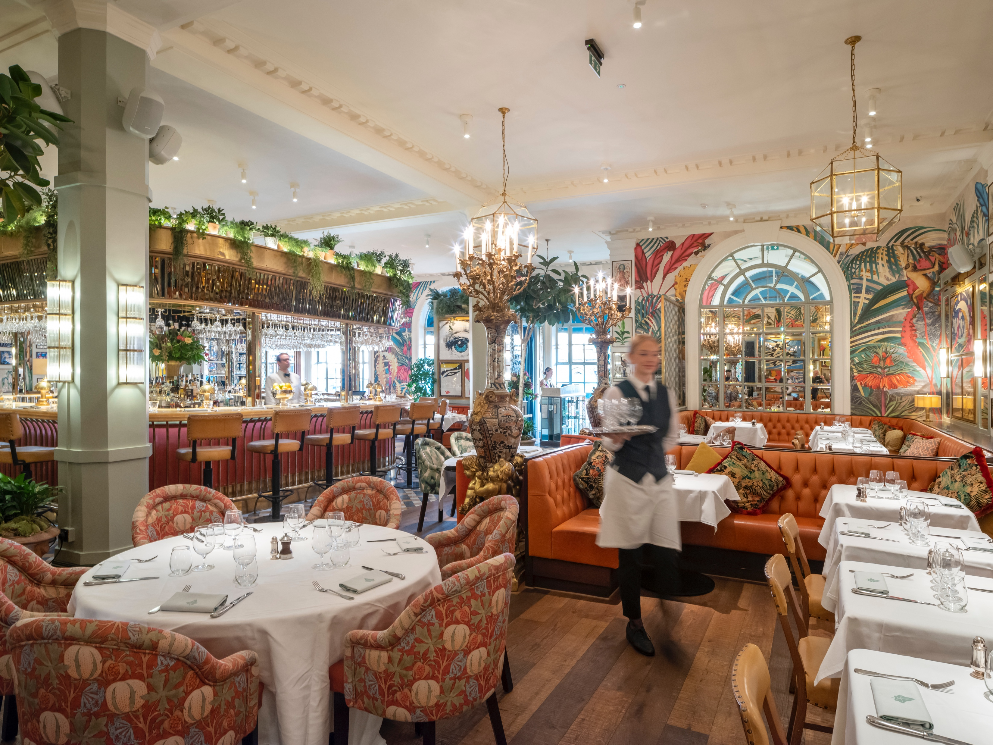
Snapshot: Customer service training at the Ivy Collection
The Ivy Collection is a group of over 40 upmarket brasseries and neighborhood cafés across the UK. All the restaurants follow a formula, but a stylish one. The location of the restaurants has always been a priority.
The Ivy Collection takes customer service training very seriously, investing a considerable amount of time and money in training staff.
Growth itself also presents staffing challenges. “It's getting tougher to find the right people as we grow.”
The Ivy Collection will also partner with suppliers to train staff. For example, they work closely with Bibendum Wine to offer specialised drinks and wine training and education.

Slide 8
Customer role in delivering service
Customer participation in service delivery and co-creation
Employees (actors), consumers (audience) interact in servicescape (service setting)
Customers can play three major roles in service delivery
  Productive resources
    Customers as ‘partial employees’
  Contribute to personal satisfaction
    Service outcome dependent on customer participation
    Customers contribute to quality service delivery
  Potential competitors
    Internal or external exchange
Notes:
S

Slide 9
Customer-to-customer interactions
Service consumption in the presence of other customers
Interactions impact consumption experiences
Important to both consumers and companies
C2C interactions successfully fostered e.g. Harley Davidson, Jeep, Apple, Saturn
Enhance quality of life through social interactions
  ‘Third spaces’
Managerial involvement in facilitating C2C
Relationship between consumer interactions and satisfaction outcomes
Notes:
S

Slide 10
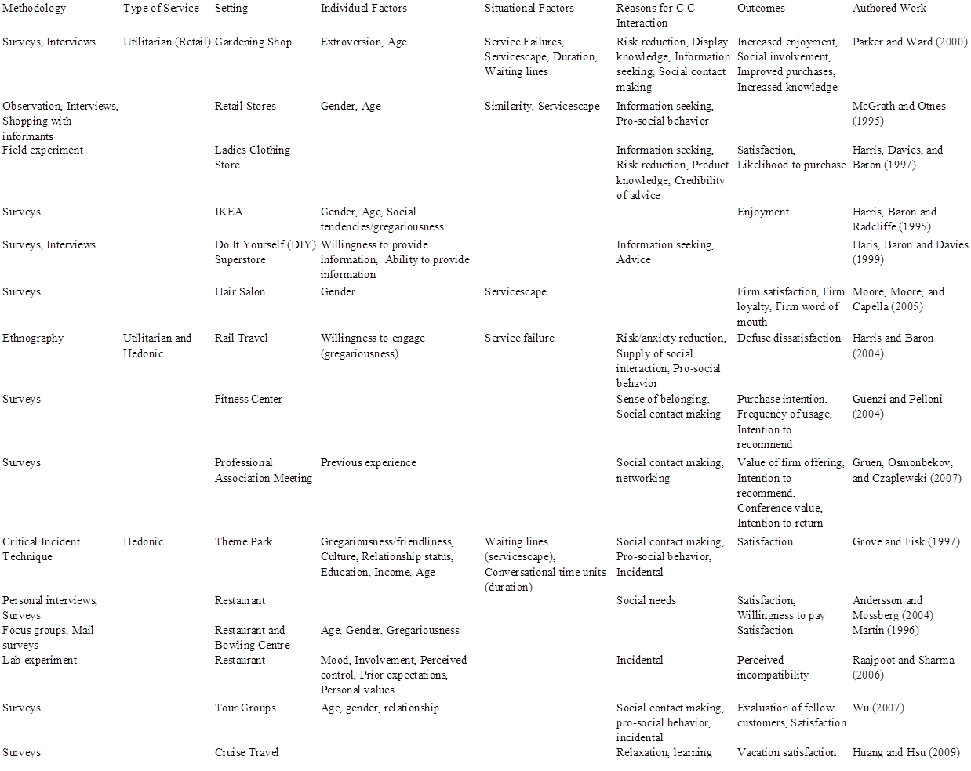
C2C Interaction Studies
Table 5.2

Slide 11
Strategies for enhancing customer participation
Figure 5.1. (based on Zeithaml et al., 2007)

Slide 12

Case Study: Hotels getting social to compete with the sharing economy
Hotels are realizing that to compete, they need to provide a more authentic, engaging, and social experience
This can be as simple as hosting a social hour for guests on arrival (eg. Sutton Place Hotel in Revelstoke, Canada)
Or completely redesigning spaces in order to encourage social interaction. (The M-Beta in Charlotte & The Bivvi Hostel in Breckenridge, Colorado)
One hotel that has developed a strong culture of social interaction and emotional engagement, all wrapped in an aura of authenticity, is the Limelight Hotel in Aspen
The hotel is packed nearly every afternoon and evening with guests and locals all seeking a fun experience.

